Slide 1
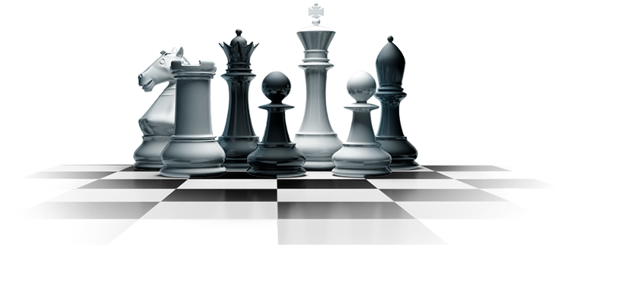
Chess AI
By Saksham, Vyomkesh and Mohit

Slide 2
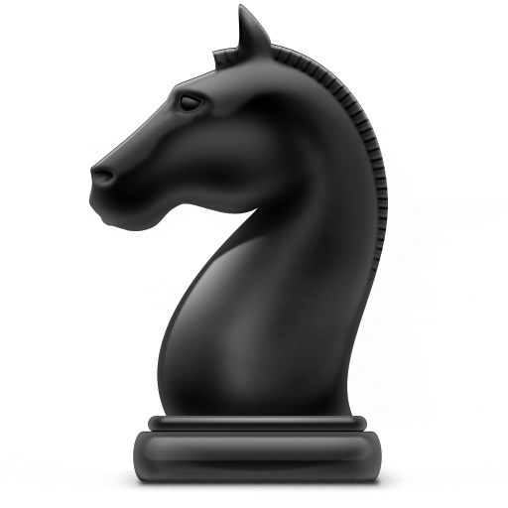
Introduction
Chess is probably the most widely researched AI problem.
Has a branching factor of 35 and an average game length of 80 half moves
A game on chess on average can be played in 10¹²³ ways.
The total number of positions in a chessboard itself exceeds 10⁴³.

Slide 3
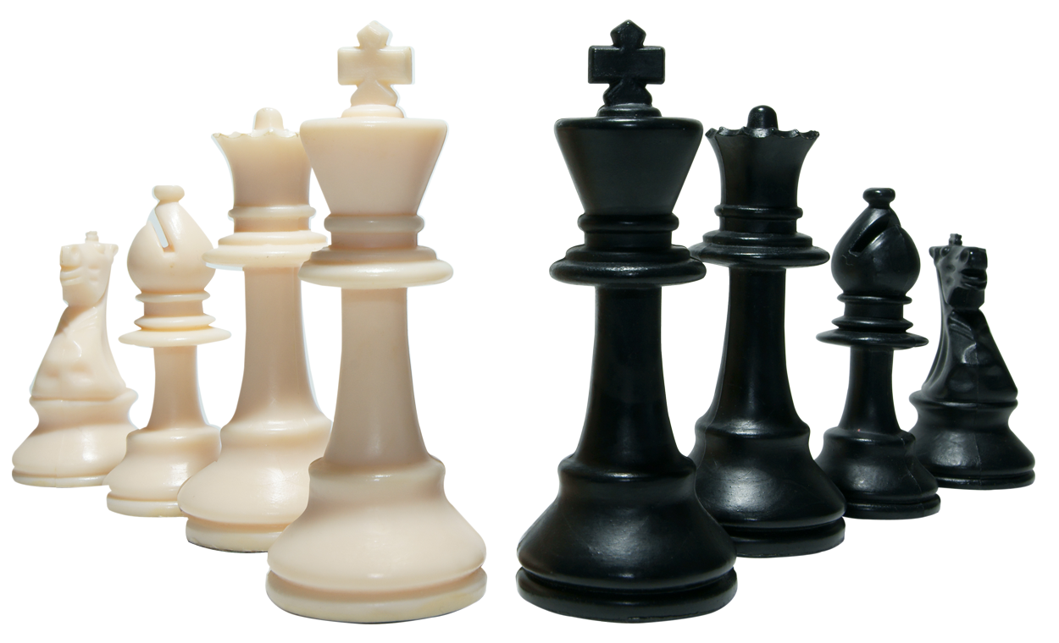
Memory-enhanced Test Driver or MTD-f
MTD(f) is a minimax search algorithm developed in 1994.
The algorithm works by calling AlphaBetaWithMemory a number of times with a search window of zero size.
The search works by zooming in on the minimax value.
MTD(f) gets its efficiency from doing only zero-window alpha-beta searches, and using a "good" bound (variable beta) to do those zero-window searches.

Slide 4
Alpha Beta with Memory
An AlphaBeta version that stores its nodes in memory as it has determined their value, and retrieving their values in a re-search.
If AlphaBeta wouldn't do that, then each pass of MTD(f) would re-explore most of those nodes.
In order for MTD(f) to be efficient AlphaBeta has to store the nodes it has searched.

Slide 5
Implementation Details

Slide 6
Chess related details
We are using the python-chess library for representing the board and move generation.
The evaluation function returns a number indicating the advantage white has in centipawns.
It comprises of 3 parameters:
Material Value : Every piece is assigned a value in centipawns.
Piece Square Tables : Every (piece, square) pair is assigned a value in centipawns.
Mobility : It is simply difference of number of legal moves for white and black.

Slide 7
Optimisations
Transposition Table
Move Ordering
Opening Books
In-place computation of evaluation metric and zobrist hash
Two first guess variables for odd and even depths instead of one

Slide 8
Testing & Performance

Slide 9
The engine was tested on two fronts:
1. How good it plays? (Skill)
2. How quickly it completes a search at some depth? (Efficiency)
The skill aspect was tested manually by playing games against the computer and at https://www.chess.com/ and https://lichess.org/. This phase was needed to test the correctness of our search, as well as to fine-tune the evaluation function.
Another phase of testing was done by making the engine play against Stockfish (a chess engine). This was done to measure the times taken for various search depths, and thus determine which optimisations give the best running time.

Slide 10
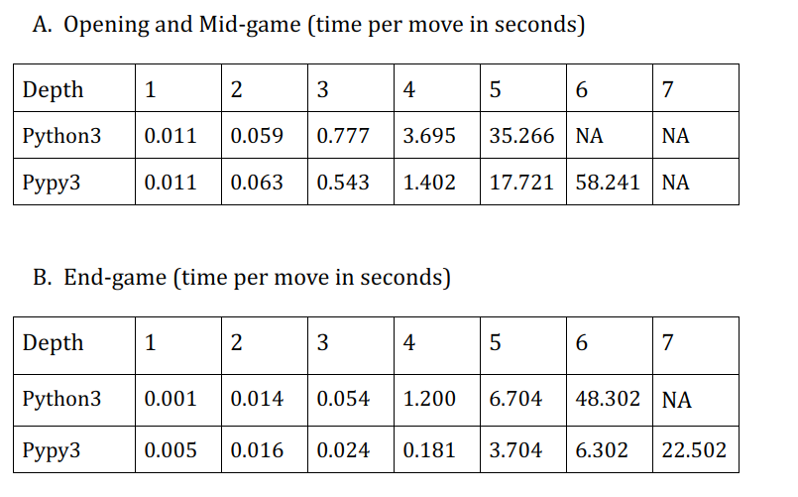

Slide 11
Accomplishments
The engine was able to beat level - 5 (rated 1200) on chess.com quite easily in a time control of 20s per move.
It was playing evenly against level - 6 (rated 1400) in a time control of 60s per move.
Playing bullet chess (total 1 minute per side) against the engine (1 sec/move) was pretty challenging for us. (On pypy3)

Slide 12
Strengths
Completes a search of depth 4 half moves very quickly.
Very strong in the opening phase because of the opening book.
Exchanges pieces whenever feasible. This reduces the branching factor, thereby allowing the search to go deeper.
Reasonably good moves by the king at different phases of the game because of different piece-square tables for the king for the mid-game and end-game.

Slide 13
Weaknesses
May incur significant losses in traps or sequence of exchanges having length greater than the search depth.
The simplicity of the evaluation function (which allows a greater search depth) causes the engine to play moves that may hinder development of pieces in the mid-game or hinder chances of pawn-promotion in the end-game.
While indulging in exchanges wherever feasible provides room to think deeper in subsequent moves, it also leads to missed wins.

Slide 14
Areas of Improvement
Switching to C++ for better performance. A significant speedup can be obtained in bitwise operations used by bitboards.
Better evaluation function. The present evaluation function is very simple. Adding more elements like doubled pawns, isolated pawns, passed pawns, etc. would improve the performance.
Better move ordering to get more cut-offs.
Allocating more space to the hash table (transposition table).

